Slide 1
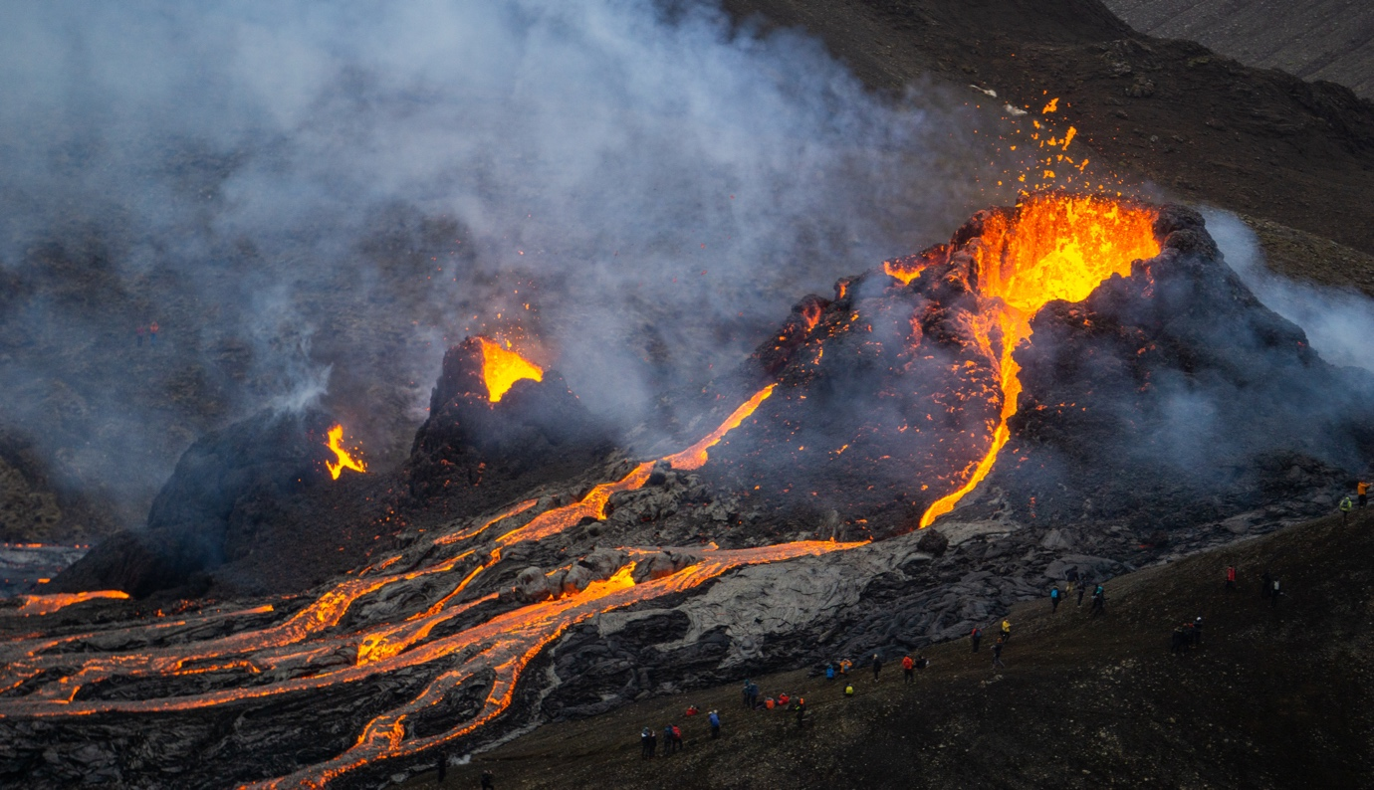
Fagradalsfjall
1
1
Introduction On Friday 19th March 2021, a volcanic eruption began near the capital, Reykjavik, in southwest Iceland. The eruption near Mount Fagradalsfjall, about 20 miles southwest of Reykjavik, took place at 8:45 pm local time. Molten rock breached the surface in a valley near a flat-topped mountain named Fagradalsfjall (beautiful valley mountain), in the region of Geldingadalur (Dale of the Geldings), six miles from the nearest town.
Context Iceland is a Nordic island country in the North Atlantic Ocean, with a population of 356,991 and an area of 103,000 km² (40,000 sq. mi), making it the most sparsely populated country in Europe. The capital and largest city is Reykjavík. Reykjavík and the surrounding areas in the southwest of the country are home to over two-thirds of the population. Iceland is a high-income country with the world’s eighth highest GNI per capita of $73 000. Iceland gained independence from Denmark in 1918 and founded a democratic republic in 1944. Iceland has a market economy with relatively low taxes, compared to other OECD countries. Iceland ranks high in economic, democratic, and social stability, as well as equality.
The country’s economy is dominated by fishing, finance, biotechnology, and manufacturing.
However, the tourist industry is expanding, aided by extensive marketing by the government. 1.7 million people visited Iceland in 2016, 3 times more than the number that came in 2010.
Iceland’s tectonic setting Iceland frequently experiences earthquakes and volcanic eruptions because it is located on the Mid-Atlantic Ridge tectonic plate boundary, which separates the Eurasian and the North American plates, forming a divergent (constructive) plate margin (see figure 1). The ridge, an underwater mountain chain, extends about 16,000 km along the north-south axis of the Atlantic Ocean. Molten magma from beneath the Earth´s crust constantly wells up, cools, and is pushed away from the ridge´s flanks, widening the gap between the continents in the process.
Iceland formed by the coincidence of the spreading boundary of the North American and Eurasian plates and a hotspot or mantle plume - an upsurge of abnormally hot rock in the Earth´s mantle. As the plates moved apart, excessive eruptions of lava constructed volcanoes and filled rift valleys. Subsequent movement rifted these later lava fields, causing long, linear valleys bounded by parallel faults. The divergence of the ridge started in the north about 150 million years ago and 90 million years ago in the south. These movements continue today, accompanied by earthquakes, reactivation of old volcanoes, and the formation of new ones.
4
2
5
3

Slide 2
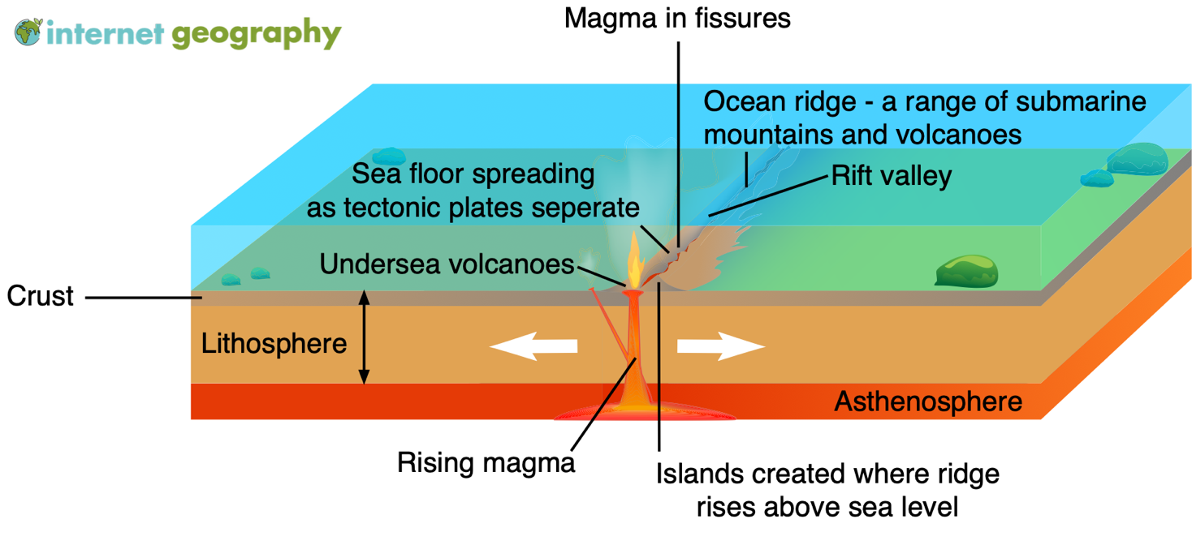
2
Figure 1 – A constructive plate boundary
6
Iceland is the largest island on the ridge because of the additional volcanism caused by the hotspot under the country, the Iceland plume. Eruptions occur about every 5-10 years and primarily consist of basaltic lava and tephra. The last major eruption on Iceland was in 2010.
The eruption In the four weeks leading to the eruption, more than 50,000 earthquakes occurred on the Reykjanes Peninsula in Geldingadalur valley, close to Fagradalsfjall, a mountain 20 miles southwest of the capital Reykjavik. The earthquakes were a significant increase from the 1,000-3,000 registered each year since 2014. Several of these earthquakes exceeded magnitude 5. The tremors are caused by rising magma and tectonic movement.
On at 8.45 pm (local time) on Friday 19th March 2021, a fissure (crack in the Earth’s surface), approximately 200 m long, opened, releasing lava. Though considered minor, the eruption spewed more than 10 million square feet of lava, sometimes in fountains reaching heights of more than 90 m. Local people were alerted to the eruption when a series of small lava fountains turned the night sky red.
Meteorologists said the eruption was small. The area is uninhabited, so the eruption is not expected to present any danger. Following the initial eruption, lava was trapped within the Geldingadalur valley (which needed to fill with lava at least 25 to 30 metres thick before it pours out of the valley). However, the lava has now flowed beyond its boundaries.
The eruption is the first in the area, the Reykjanes Peninsula, in 781 years. It is the first time this particular volcano has erupted in about 6,000 years.
The initial eruption led to around 300,000 cubic metres (10.5 million cubic feet) of lava have poured out. However, experts deem the eruption to be relatively small and controlled.
Lava first poured out of a meandering fissure, however over the first weekend, the eruption focused its output on a single spot, building a steep, towering cauldron of freshly cooled rock. Smooth rivers of lava crept around blockier, rubble-like lava.
Vulcanologists describe the eruption as “effusive”. Lava flows out of the volcano onto the ground instead of being “explosive”, wherein magma, along with ash, is violently fragmented and rapidly expelled from a volcano.
Throughout the eruption, ejected molten lava has landed on the sides of the vent and solidified. Over time, this builds a cone around the vent. This is typical of effusive fissure eruptions of low viscosity, basaltic lava. The spatter cone is relatively weak and is susceptible to collapse. When this occurs, large volumes of lava flow rapidly out of the cone as unconfined lava. These events are unpredictable and can immediately change the direction and speed of a lava flow.
Scientists suggest the heightened volcanic activity represents a transition from a gradual opening of the Mid-Atlantic rift to a considerably more dramatic phase when both sides of the Reykjanes Peninsula rapidly separate. When a geologic rift quickly pulls the land apart like this, it creates a space, and magma rushes up to fill it in, causing Icelandic lava eruptions.
11
7
12
13
8
14
9
15
10

Slide 3
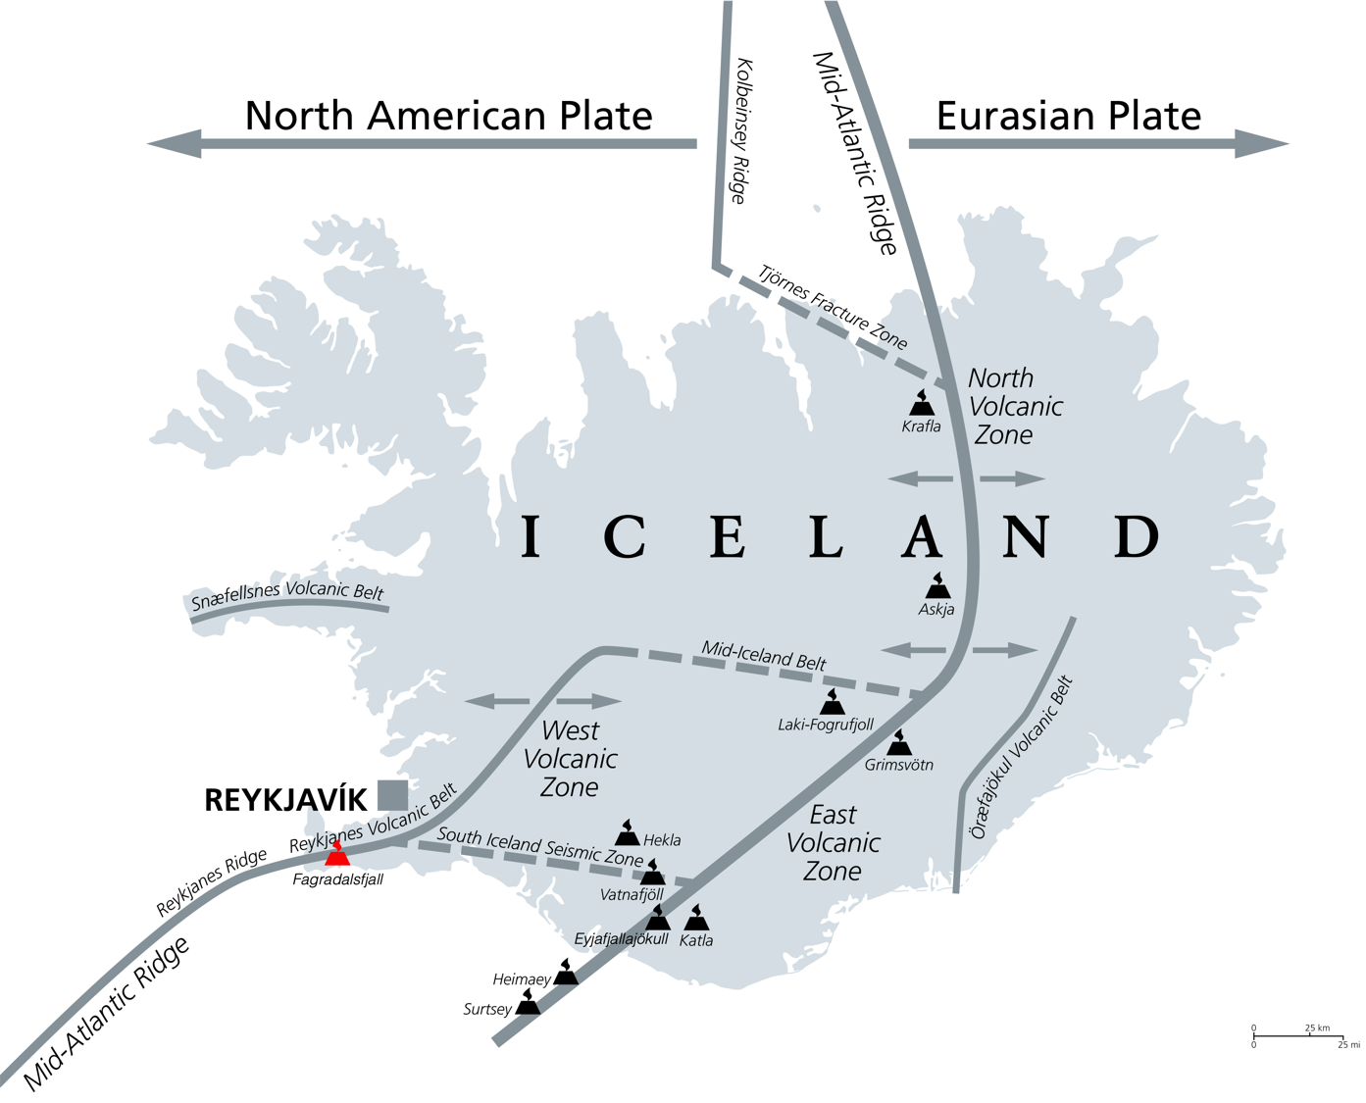
3
Figure 2 – Iceland's tectonic setting
16
Studies of the lava by vulcanologists indicate that the magma is a primitive basalt that originates from deep within the Earth’s mantle.
Hazards The main hazard from the eruption is the potential danger of toxic sulphur dioxide gas. This gas can pose a deadly and silent threat to human populations. Acid rain is produced when SO₂ combines with atmospheric water, enhancing weathering and damaging crops and polluting surface water and soils.
Another hazard posed by the eruption is the collapse of the fragile volcanic cones formed from lava spatter. The failure of the delicate cones can lead to rapid lava flows along with avalanches of hot, volcanic rock.
As the area is very active, fissures can quickly form, presenting a risk to tourists visiting the site. Additionally, as the lava has a low viscosity, it can flow rapidly.
Implications for people living in tectonically active areas The site was initially closed to the public until officials had completed safety assessments. From the afternoon of Saturday 20th, March 2021, people were allowed to trek to the site. People made the difficult hike to the area over the weekend to witness the eruption up close, and local helicopter companies offered tours from Reykjavik.
By Monday, the site was closed again due to high gas pollution levels and poor weather conditions. Emergency services had to rescue several people from the area on Sunday night, following reports of missing people.
The earthquakes that preceded the eruption have mostly subsided now that magma has reached the surface.
The current volcanic activity is very different from the 2010 eruption of Eyjafjallajökull, a stratovolcano that led to the eruption of millions of ash and gas into the atmosphere, closing European airspace. It is not anticipated the current eruption will release significant quantities of ash or smoke into the atmosphere.
17
21
18
22
23
19
20

Slide 4
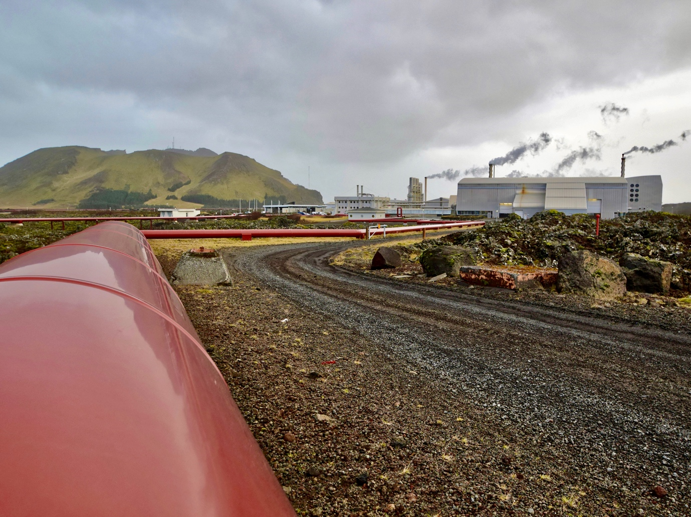
Why do people live in tectonically active areas? Iceland is a pioneer in the use of geothermal energy for space heating (see figure 3). Generating electricity with geothermal energy has increased significantly in recent years. Geothermal power facilities currently generate 25% of the country's total electricity production.
Since the eruption of Eyjafjallajökull in 2010, the government has promoted Iceland’s unique volcanic environment leading to a boom in international tourism.
Management, monitoring and response The Icelandic Meteorological Office (IMO) is not only Iceland’s national weather service, it is also responsible for monitoring volcanic and seismic activity. The IMO has an extensive network of seismic monitoring stations across the country. The IMO said the eruption of Fagradalsfjall began at about 20:45 GMT on Friday and was later confirmed via webcams and satellite images.
A coastguard helicopter was immediately sent to survey the area, about 30 km (19 miles) from Reykjavik.
Immediately following the eruption, Iceland’s prime minister Katrín Jakobsdóttir announced on Twitter, “A volcanic eruption has begun in Fagradalsfjall on the Reykjanes peninsula. We are monitoring the situation closely, and as of now, it is not considered a threat to surrounding towns. We ask people to keep away from the immediate area and stay safe”.
A coastguard helicopter was sent to survey the area, about 30 km (19 miles) from Reykjavik.
Following safety assessments, the government opened the eruption site to the public after several days. As the site is remote and difficult to access due to the uneven surface formed from previous lava flows and a 90-minute hike from the nearest main road, authorities marked out routes to access the site. The paths resolved the problems caused by people becoming lost in the dark in the early days of the eruption.
Monitoring equipment has been installed at the site, including devices to measure CO₂ levels and webcams to monitor the eruption.
Conditions at the site are continually monitored, with daily notices issued to the public regarding the site’s safety. High CO₂ levels, dangerous weather conditions and volcanic activity have led to the area being temporarily closed to the public since the initial eruption.
4
24
29
25
30
26
31
27
32
28
Figure 3 – A geothermal energy plant in Iceland

Slide 5
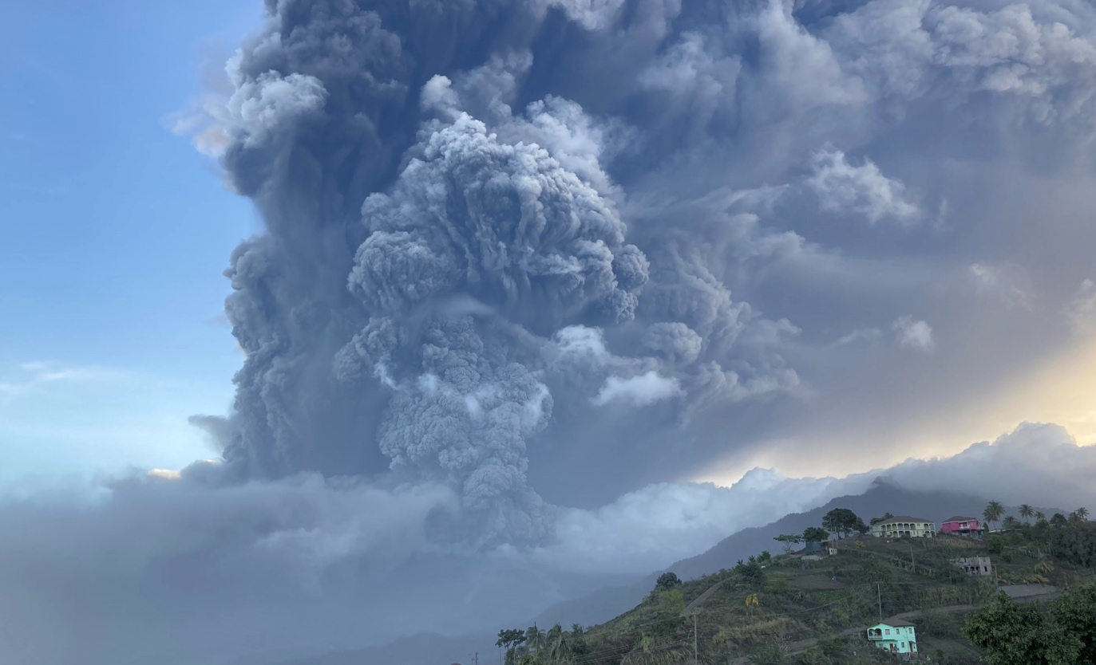
La Soufrière
5
33
Introduction On Friday 9th April 2010, the La Soufrière volcano erupted in the northern part of the Caribbean island of St Vincent (part of St Vincent and the Grenadines), about 20km north of the capital of Kingstown. An explosive eruption began at 8:41 am local time, sending an ash plume 8 km into the sky. La Soufrière is the highest peak on the island of St Vincent, and the highest point in the country, at 1,234 m above sea level (4,049 ft), and is the island’s youngest and northernmost volcano.
Context The island of St Vincent is part of the island chain country of St Vincent and the Grenadines, located in the southeast Windward Islands, which form part of the West Indies, where the Caribbean Sea meets the Atlantic Ocean. St Vincent and the Grenadines has a population of 110,211 and an area of 369 km² (142 sq mi). The country is made up of the main island of Saint Vincent and the northern two-thirds of the Grenadines. The Grenadines are a chain of 32 smaller islands - some of which are inhabited, whilst others are not. The capital and largest city is Kingstown in the south-west of the island of St Vincent, which is also the island’s main port. St Vincent and the Grenadines is a low-income country with a GNI per capita of $7,460. Formerly a British colony, the country became the last of the Windward Islands to gain independence in 1979, although Queen Elizabeth II is still the Head of State. St Vincent and the Grenadines is a democratic country with no formal armed forces. The country’s economy is dominated by agriculture, and in particular banana production, however, the tourist industry is growing rapidly, aided by improvements to the country’s infrastructure.
St Vincent’s tectonic setting La Soufrière (also known as Soufrière Saint Vincent) is an active stratovolcano. Stratovolcanoes are also known as composite volcanoes as they are built up of many layers of hardened lava and tephra, and have a steep profile with a crater lake at the summit. They are conical in shape as their highly viscous lava typically cools and hardens before spreading out too far. The magma below ground is often felsic (igneous rocks that are rich in the elements that form feldspar and quartz).
The island of St Vincent is vulnerable to volcanic eruptions because it is located on the convergent (destructive) plate margin separating the North American Plate from the Caribbean Plate. At this boundary the two plates are moving towards each other. The North American Plate, which is the denser of the two, sinks beneath the Caribbean Plate, which causes the North American Plate to melt, forming magma, which then rises to the surface when it can erupt forming a volcano. This process is called
35
34
36

Slide 6
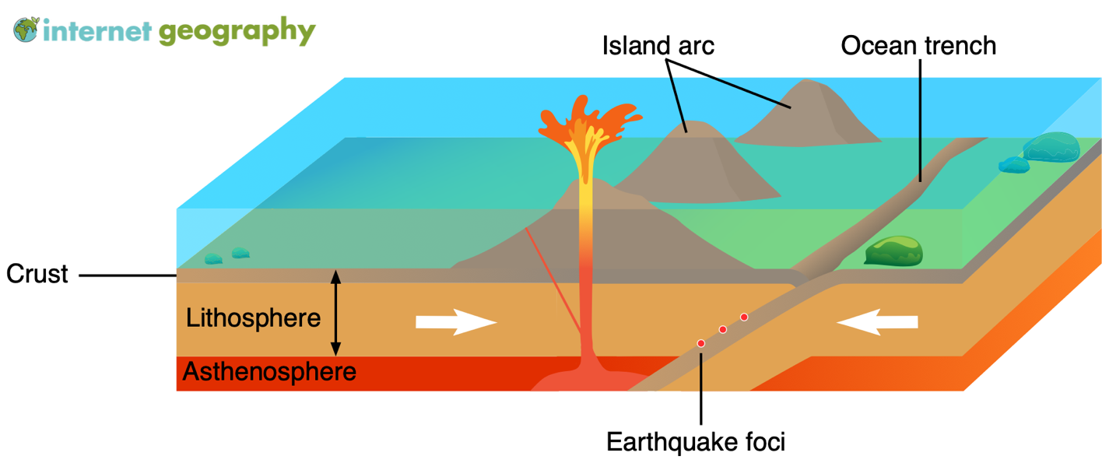
6
Figure 4 – An oceanic-oceanic crust convergent plate boundary
subduction and is what formed the volcanic islands, along with their steep-sided conical peaks, of the Eastern Caribbean.
La Soufrière has experienced five explosive eruptions since records began, in 1718, 1812, 1902, 1979 and 2021, with the most deadly event in 1902 which killed 1,680 and left a further 600 people badly burned, and another 4,000 homeless. It also wiped out the last of the indigenous Carib population. The crater lake had been reformed within five years of this eruption so the volcano was considered no longer active. The 1979 eruption had no confirmed casualties as the government put in place an effective evacuation plan, moving residents to the safety of nearby beaches.
The eruption La Soufrière had been dormant since 1979, but in late 2020 started showing signs of activity - rumbling and spewing steam and smoke. On 27th December a new lava dome had been formed by an effusive eruption, so the government began to review their evacuation plans throughout January 2021 in case the effusive eruption showed signs of becoming explosive. During this time the lava dome grew to 100m tall, 200m wide and 900m long, and continued to expand further throughout February, when it also began to emit gas and steam plumes from the summit, as well as small rock falls, and there were clear signs of damage to vegetation. By the end of March the lava dome measured 105m tall, 243m wide and 921m long. During early April monitoring observed a sustained increase in volcanic and seismic activity, including regular small earthquakes which were felt in the nearby communities of Fancy and Chateaubelair. On Thursday 8th April a lava dome was clearly visible, causing the government to declare a red alert, ordering 16,000 people to evacuate the area around La Soufrière as an explosive eruption was imminent. Residents of St Vincent were housed temporarily on the neighbouring islands of Antigua, Barbados, Grenada and St Lucia. However the evacuation effort was hampered by Covid-19 as the Prime Minister Ralph Gonsalves announced that people must be vaccinated in order to board the cruise ships or be granted refuge in other countries.
At 8:41 local time on Friday 9th April 2021, La Soufrière erupted in an explosive manner. The plume of volcanic ash reached approximately 8,000m into the sky and began to drift eastwards towards the Atlantic Ocean. Explosions were observed over the following days - a second explosion occurred that evening, with a third on 11th April. White-coloured dust covered buildings and roads around the island, including the capital of Kingstown. The presence of thick ash and smoke closed air space over the island, and caused power outages as well as disruptions to food and water supply. In the early hours of Monday 12th April, a huge eruption triggered pyroclastic flows down the volcano’s south and south-west flanks.
Hazards Throughout both the effusive and explosive phases of La Soufrière’s activity, a significant amount of toxic sulphur dioxide was released into the atmosphere - which poses a silent, yet deadly threat to people. Sulphur dioxide also combines with water in the atmosphere which produces acid rain, which causes an increase in
37
39
38
40

Slide 7
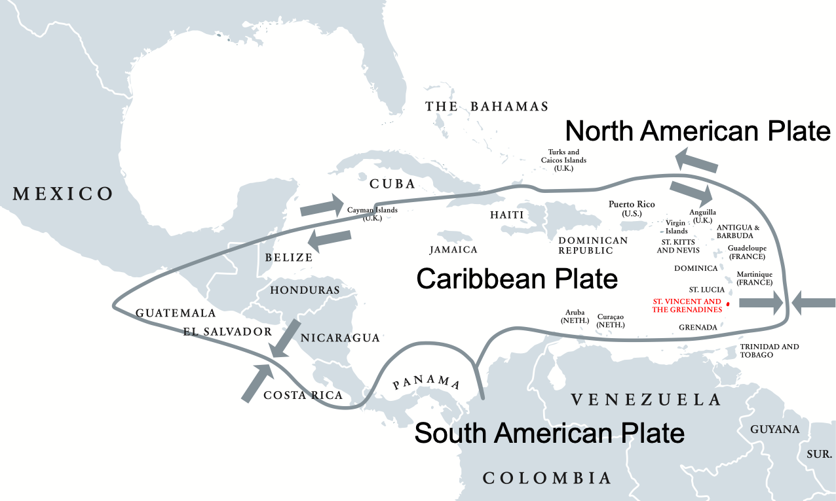
7
Figure 5 – St. Vincent and the Grenadines tectonic setting
chemical weathering, as well as contaminating water and causing extensive damage to crops. The impact on crops is particularly problematic in a low income country like St Vincent and the Grenadines, where farming provides the livelihood of a significant proportion of the population.
Implications for people living in tectonically active areas La Soufrière is located in the north of St Vincent, so the northern half of the island was most severely affected. Although 16,000 residents evacuated, 3,200 stayed in government shelters, with another 20,000 people needing shelter. Nearby countries sent emergency supplies, such as water, food and medicine. The UN warned of a humanitarian crisis, exacerbated by Covid-19 - with major concerns over the lack of water and positive cases being reported in the crowded shelters. The government has warned the 16,000 residents who have been evacuated that they may be displaced for 3-4 months.
The impact on agriculture is significant. Many people in low income countries, such as St Vincent and the Grenadines, choose to live around the slopes of volcanoes as lava and ash add nutrients to the soils, making them more fertile, and therefore increasing crop yields. However this eruption was so explosive that the blanket of ash destroyed all crops and killed livestock, which will take years to recover from. A number of houses also collapsed under the weight of the ash. When La Soufrière erupted it released an ash plume of approximately 10,000m. Huge plumes of smoke reached the neighbouring island of Barbados, 190 km away, with residents being urged to stay indoors due to the harmful gases, and being warned of weeks of falling ash, which could make driving conditions hazardous. People on St Lucia, 76 km north of St Vincent, have also been warned to expect air quality to be affected, with harmful gases potentially causing breathing difficulties for people with asthma and other respiratory conditions.
Why do people live in active regions? St Vincent and the Grenadines is a low income country and its economy is dominated by agriculture, and in particular banana production. Because the majority of residents earn their living through farming they choose to live around the slopes of La Soufrière, as lava and ash historically have added nutrients to the soils, increasing fertility and thus crop yields. Volcanic rocks are extremely tough and resistant so also provide good building materials.
Management, monitoring and response In December 2020 volcanologists were on high alert after observing that La Soufrière was experiencing increased activity, with monitors reporting tremors, gas emissions, the formation of a new volcano dome and changes to its crater lake. During late December government officials communicated their concerns with residents and began to review evacuation plans in case an explosive eruption was imminent.
43
41
44
42
45

Slide 8
46
Throughout January and February 2021, scientists continued to monitor activity - measuring the dome and recording temperatures, as well as observing gas emissions and steam plumes. On 1st February sulphur dioxide emissions were detected, suggesting that groundwater was beginning to dry up. On 7th February the same group of scientists recorded a five degree increase in temperatures and detected hydrogen sulphide at the Willibou Hot Spring, prompting the National Emergency Management Organisation (NEMO) to warn the public to stay away from the volcano.
Throughout March the monitoring team continued to observe gas and steam emissions, and on 23rd March the Regional Monitoring Network detected a series of low-frequency seismic events, lasting approximately 45 minutes, caused by magma movement beneath the dome. These escalated into a number of small volcanic earthquakes felt in the neighbouring communities over the next few days. They also observed the continued growth of the lava dome, along with steam and gas emissions, and another series of volcanic earthquakes, which had increased in intensity.
On 8th April scientists deemed that an explosion was imminent, so the island was put on Red Alert, with an evacuation issued by the government to 16,000 people in the area surrounding the volcano. Neighbouring countries agreed to take in evacuees, however people were not allowed to the cruise ships used in the evacuation or be granted refuge on another island, without Covid-19 vaccine. Shortly after the explosion the International Volcanic Health Hazard Network warned residents of the risk from ash and sulphur dioxide to asthmatics and others with chronic health conditions.
From 11th April neighbouring countries stepped up their efforts to provide assistance. Venezuela sent humanitarian supplies to aid the relief effort, along with risk experts and the Barbados Defence Force was deployed to provide further humanitarian assistance and disaster response. Trinidad and Tobago sent 50 members of their defence force to provide medical, logistical and infantry support, Grenada pledged more than $1 million in emergency supplies, including food and water, and both Montserrat and St Kitts and Nevis offered aid packages including money and essential supplies. Caribbean mobile phone network Digicel, offered to donate £500,000 of essential items to NEMO.
Further afield, the UK announced a £200,000 package to immediate humanitarian aid, along with technical experts to help restore critical infrastructure like transport links and communications. The UN Environment Programme agreed to help remove debris and ash, and agreed to consider the request from PM Ralph Gonsalves, and the World Bank announced financial aid of $20 million from its Catastrophe Deferred Drawdown Option.
49
47
50
48

Slide 9
Glossary
Basaltic lava – A thin, very fluid lava, that forms dense igneous rock when it cools.
Chemical weathering – The breakdown of rock in situ, caused by chemical reactions.
Convergent plate margin - A tectonic boundary where two plates are moving toward each other.
Crater lake - a lake in a crater formed by explosive activity or a collapse during an eruption.
Effusive eruption - a type of eruption where lava steadily flows out of the volcano onto the ground.
Divergent plate margin - A tectonic boundary where two plates are moving away from each other and new crust is forming from magma that rises to the Earth's surface between the two plates.
Felsic - describes igneous rocks that are rich in elements that form feldspar and quartz.
Fissure – A linear fracture on the Earth's surface through which lavas, pyroclastics, and gas are erupted and effused.
Geothermal energy – Energy obtained by tapping underground reservoirs of heat, usually near volcano es or other hot spots on the surface of the Earth.
High income country (HIC) – A nation with a gross national income per capita of US$12,536 or more in 2019.
Humanitarian aid – Providing material and logistic assistance to people who need help.
Humanitarian crisis - An event or series of events that represents a critical threat to the health, safety, security, or wellbeing of a community or other large group of people, usually over a wide area.
Indigenous population - Communities that live within, or are attached to, geographically distinct traditional habitats or ancestral territories, and who identify themselves as being part of a distinct cultural group, descended from groups present in the area before modern states were created and current borders were defined.
Lava dome - circular mound shaped protrusion resulting from slow extrusions of viscous lava.
Lava spatter - Blobs of lava thrown a little ways into the air (by expanding gases) that is still molten when it lands.
Low viscosity - Substances that are thin and runny.
Mantle plume - An upwelling of abnormally hot rock within the Earth's mantle.
Mid-Atlantic ridge -
Organisation for economic co-operation and development (OECD) - intergovernmental economic organisation with 37 member countries, founded in 1961 to stimulate economic progress and world trade.
Pyroclastic flow – A dense, destructive mass of very hot ash, lava fragments, and gases ejected explosively from a volcano and typically flowing at great speed.

Slide 10
Glossary
Rift valley - A steep-sided valley formed by the downward displacement of a block of the earth's surface between nearly parallel faults or fault systems.
Stratovolcano - steep conical volcano built up of many layers (strata) of hardened lava and tephra - also known as composite.
Subduction - The sideways and downward movement of the edge of a plate of the earth's crust into the mantle beneath another plate.
Tephra - fragmental material produced by a volcanic eruption.
Vent – A hole or fissure in the ground from which lava and other volcanic products emerge.
Viscous lava – Molten rock above the Earth’s surface with a high silica content that is thick.

