Slide 1
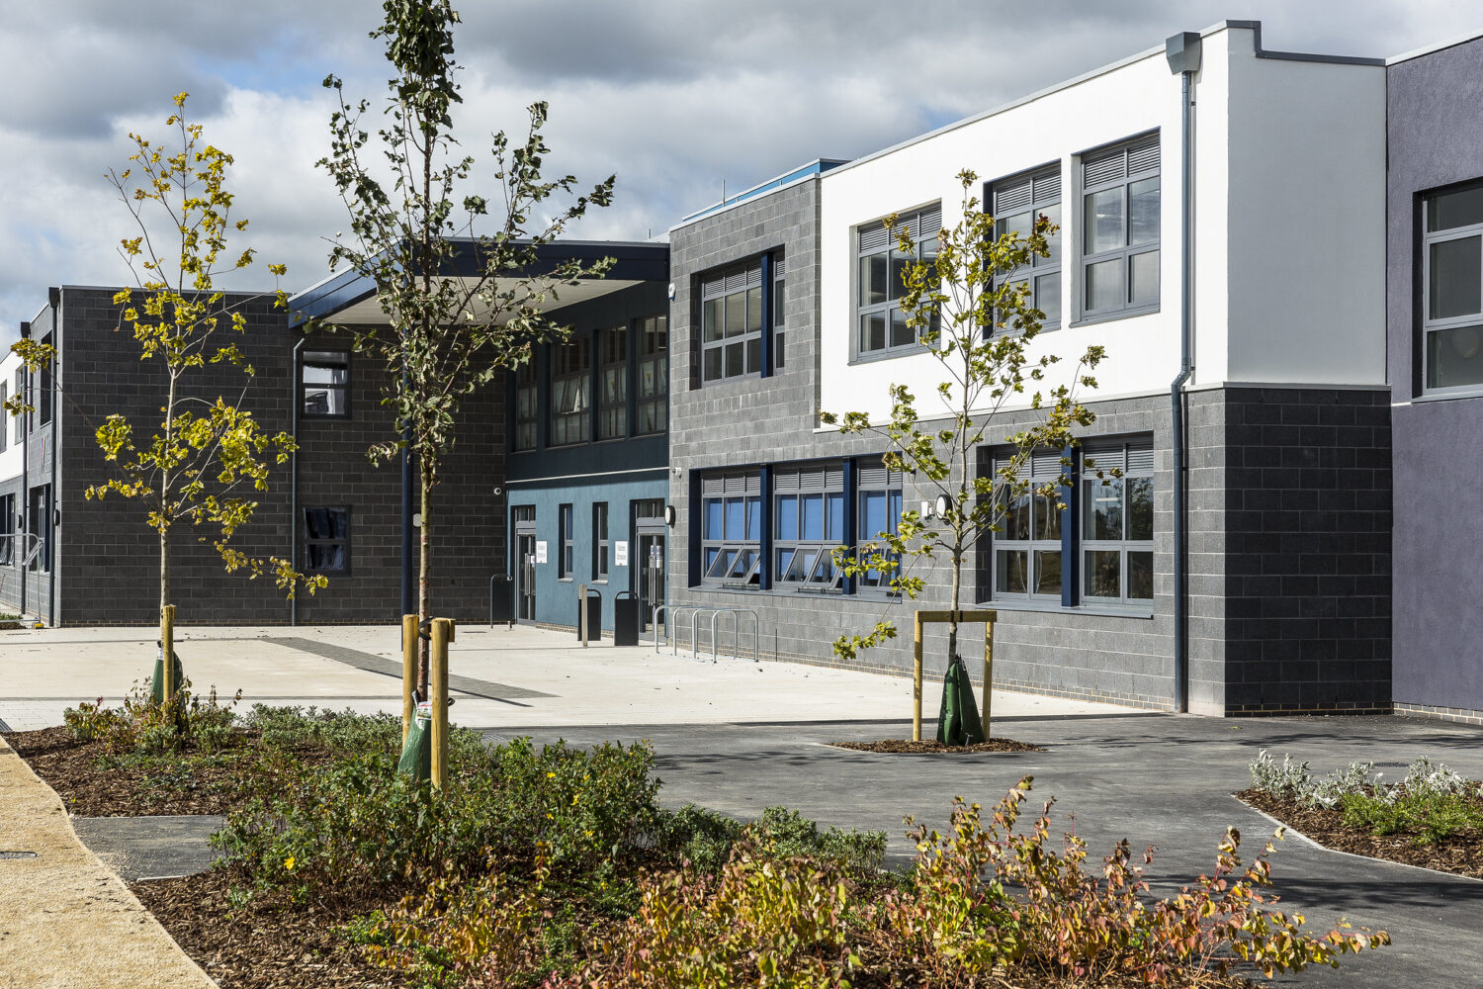
Art Bridging Project 2024 Natural Forms
Hello, welcome to the art department at Wixams. My name is Miss Correya, I am one of the art teachers. I look forward to meeting you all and working together.
Printing methods

Slide 2
We will be investigating the various printing methods
Monoprinting – a) additive and b) subtractive
Press printing
Collograph printing
Etching
Lino printing
Screen printing

Slide 3
Choose one printing method to investigate.
Start off by researching that printing method, when and how did it start?
Find an artist who used this printing method (there is a list at the end of this PP) and give a brief description of them – to include when, where they were born. What they did, how they did it, why they did it?
Then try out the method.
Evaluate the outcome with strengths and areas for development.

Slide 4
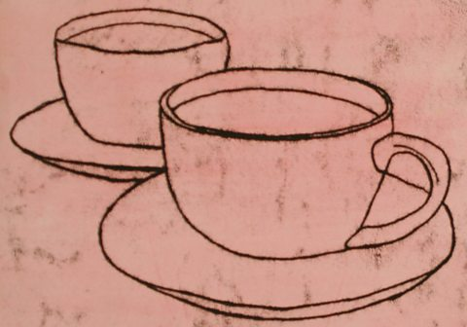
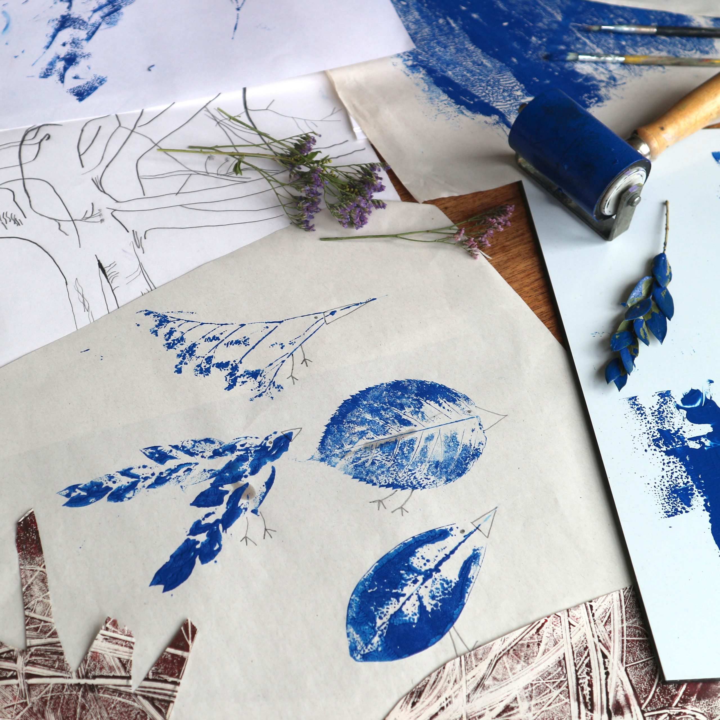
1. Monoprinting
READ
Monoprinting - Printmaking - AQA - GCSE Art and Design Revision - AQA - BBC Bitesize
Monoprinting is mainly used for fine art prints and textiles work.
It is used for single prints or small batches. Only a limited number of prints can be created this way as each print removes a layer of ink from the acrylic sheet.
Monoprints are usually limited to one colour. Try layering multiple monoprints on the same piece of fabric or paper.

Slide 5
1a) Additive
NOW TRY
Find a piece of clear plastic
Find some leaves or feathers
Roller out your ink/paint
Using a brush, or roller, paint onto your leaf
Place a piece of paper on top of the painted leaf or feather
Press down carefully or use a clean roller
Carefully peel off the paper to reveal your printed image.

Slide 6
1b) Subtractive
NOW TRY
Find a piece of plastic
Use something to coat it with, such as paint (it can be household paint) or felt tip and water added to it by using a brush or coffee granules and water.
Firstly, get an image printed (this can be off the internet or from magazine/newspapers).
Place it picture side up, on top of the painted plastic.
Using a pen, draw over the main areas of the image, making sure you press down firmly.
Carefully peel off the image to reveal your printed image.

Slide 7
2. Press Printing
Find some polystyrene from a parcel that has been delivered.
Cut it to a manageable size.
Don’t forget that any image you decide to do, has to be reversed onto the polystyrene. If you don’t do this, it will be printed backwards.
Please follow the steps on the next slide.

Slide 8
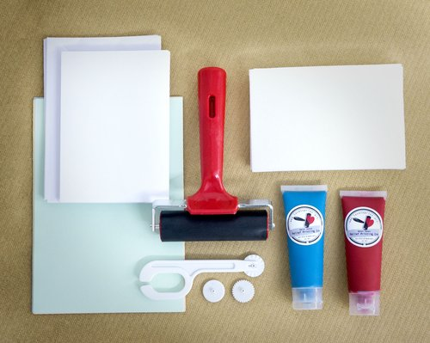
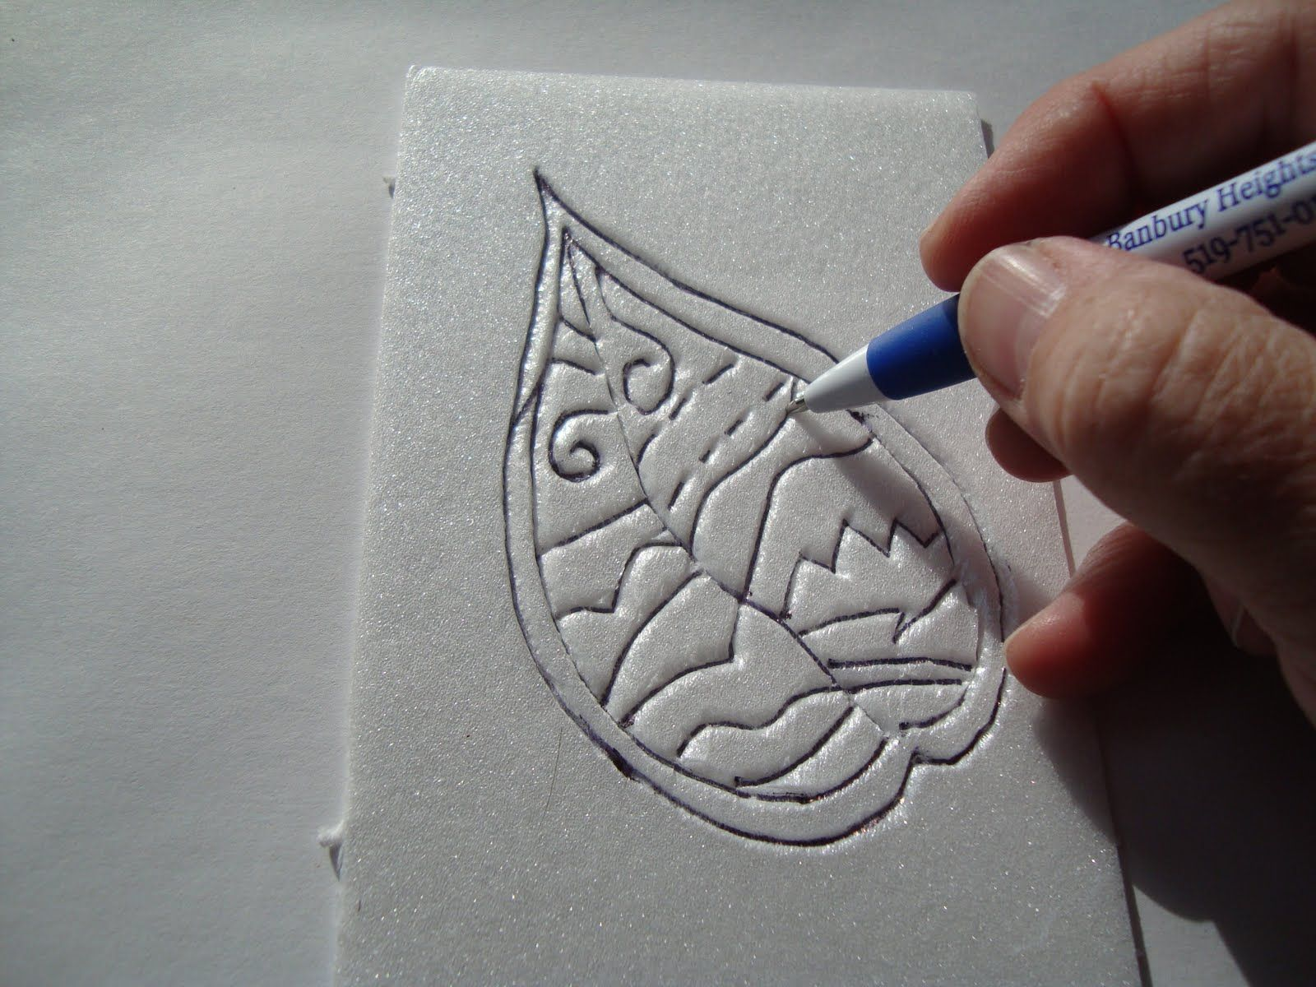
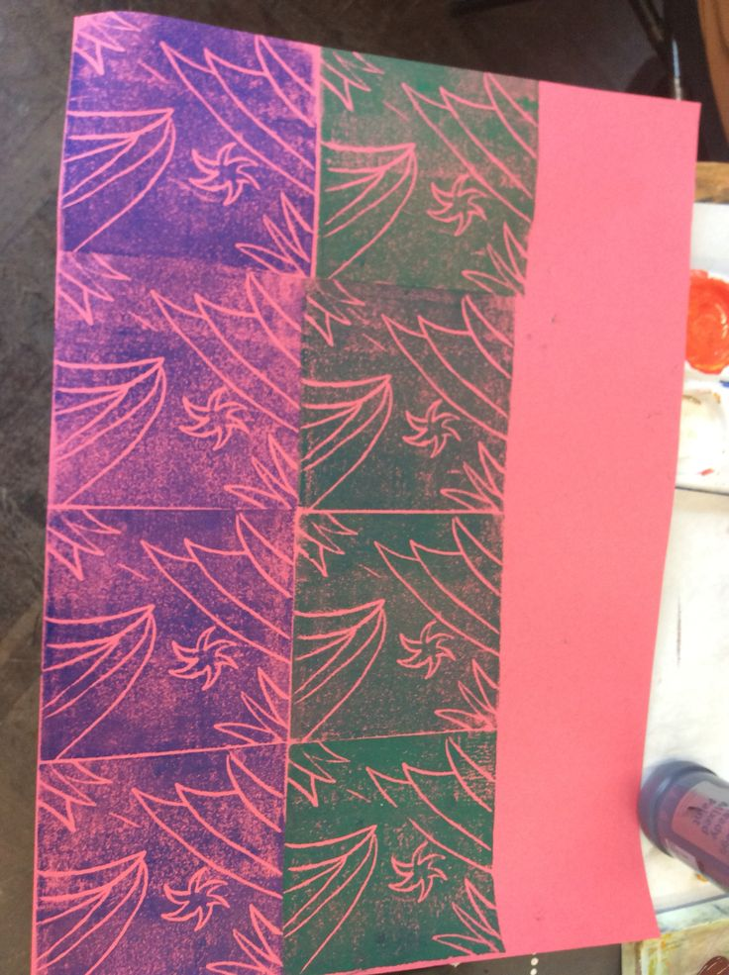
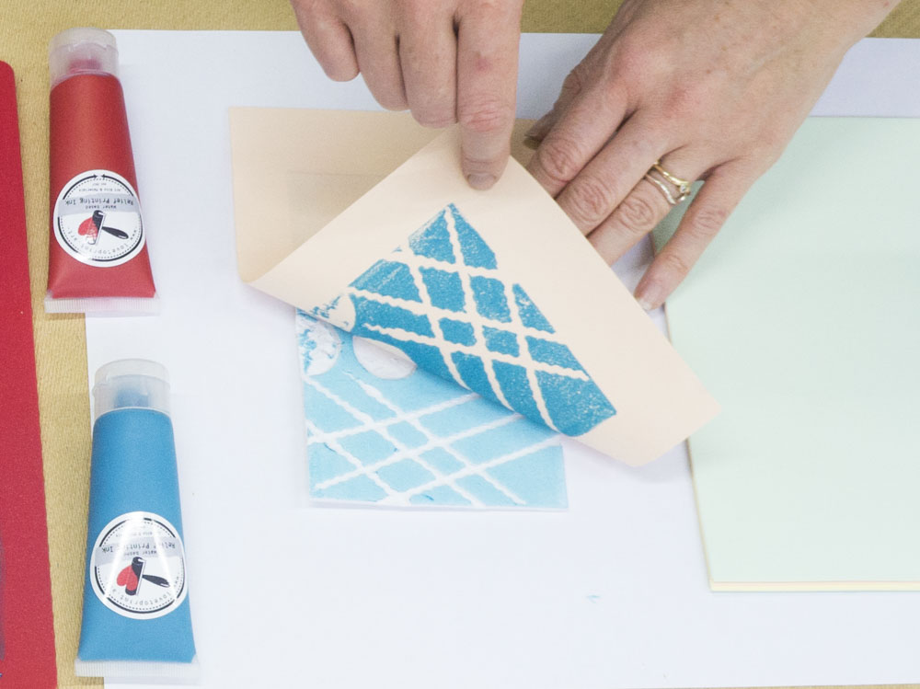
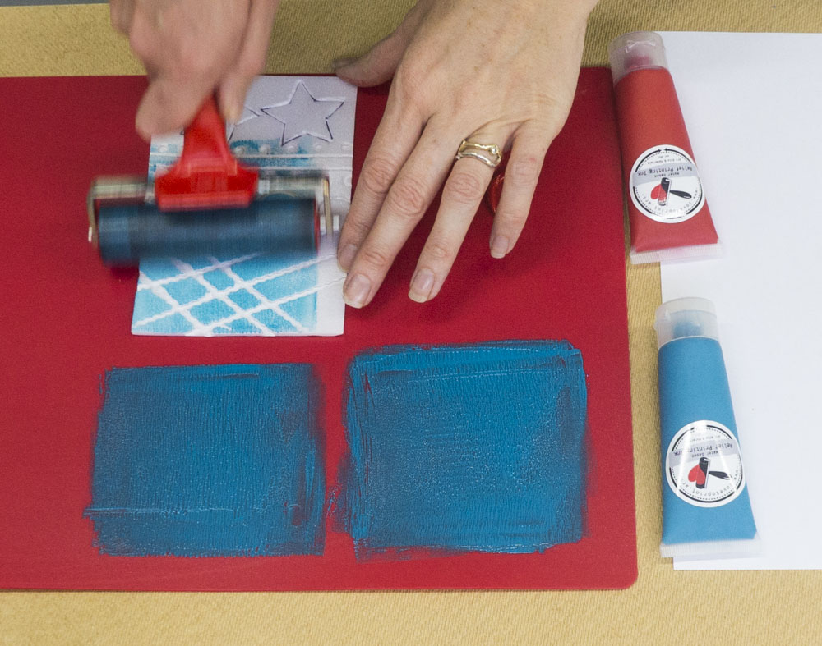
Press Print method
https://youtu.be/2ORQs28yXsg?si=xqQ0qc5qIyEF6aof

Slide 9
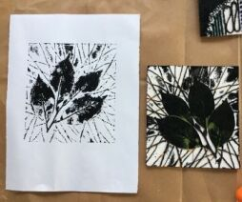
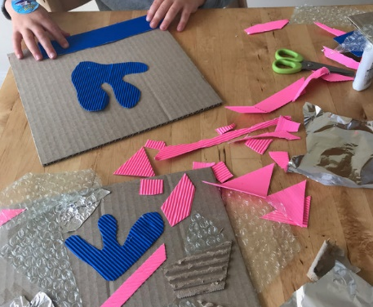
3. Cardboard Collagraph Printing
This is a fantastic project to explore the concept of texture.
MATERIALS:
Thick cardboard to make the base of your building block
A selection of textured materials like; bubble wrap, corrugated cardboard, tin foil or string
Glue
Thick printing ink (or paint) and a brush
Paper to print onto

Slide 10
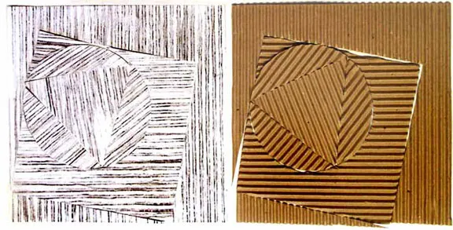
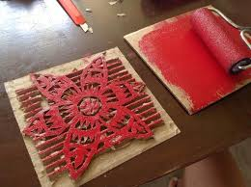
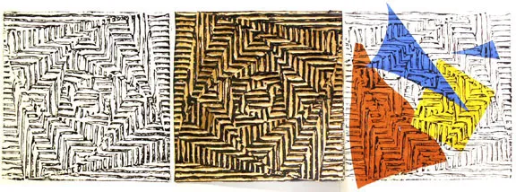
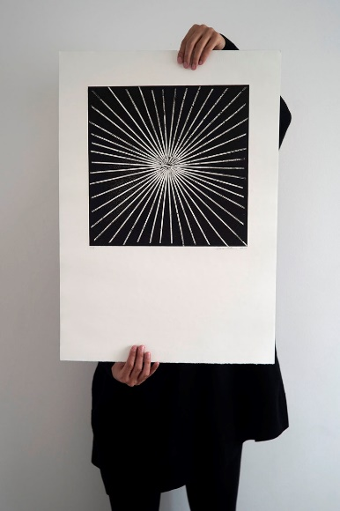
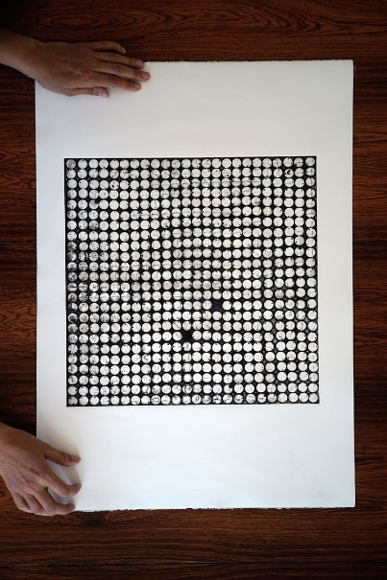
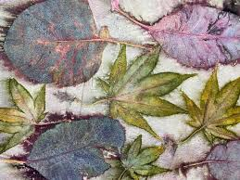
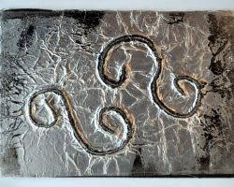
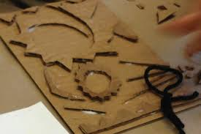
HOW TO:
Cut out some base boards for the printing block from thick cardboard. Then cut out lots of different shape textured materials. Glue them onto your base board to make a pattern.
Paint the different textures
Lay a piece of paper on top
Using a roller or your hands, transfer the print to the paper

Slide 11
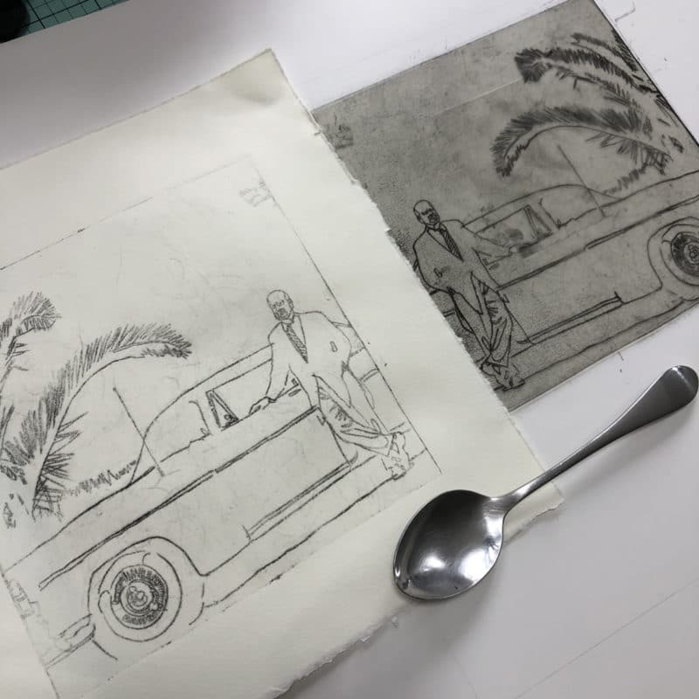
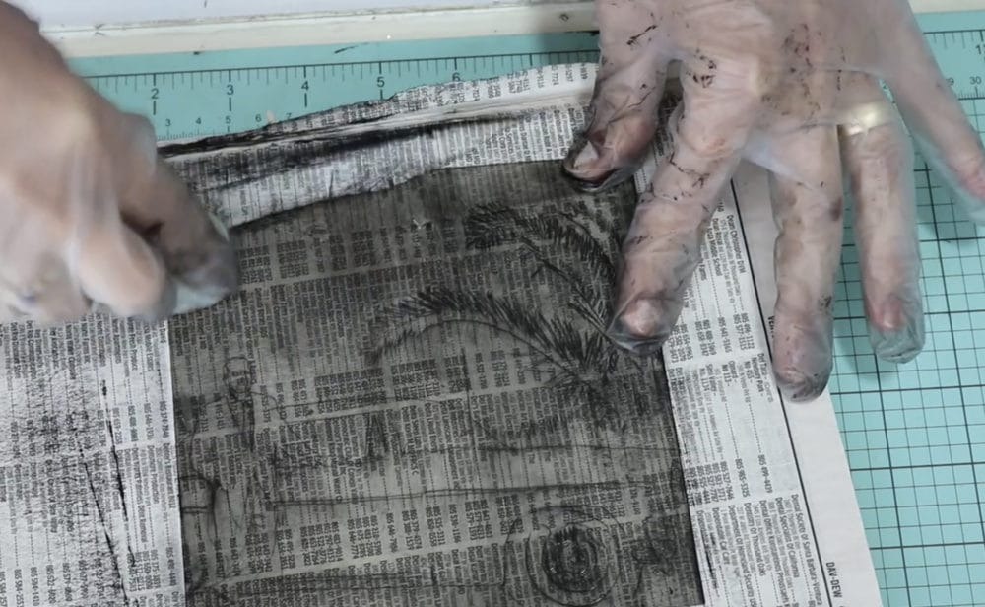
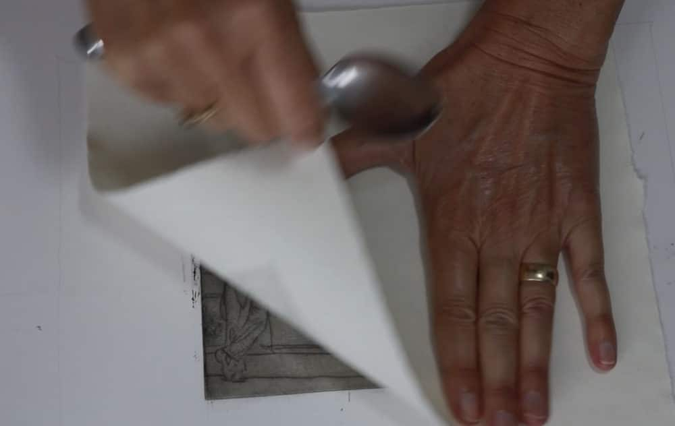
Etching
How to Make a Drypoint Etching from Recycled Plastic, and Print it without a Press - Belinda Del Pesco

Slide 12
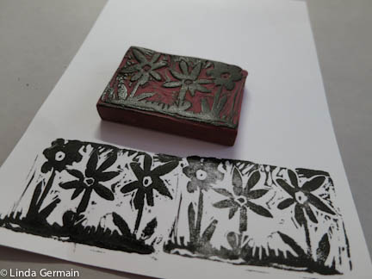
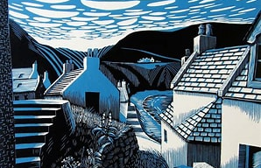
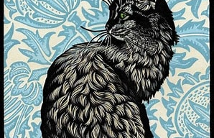
Lino Printing
Make an eraser relief block for printmaking - Linda Germain
Use a large eraser
Draw your design onto it
Using a pair of scissors opened or a craft knife, cut away the areas that you don’t want printed, leaving the parts raised that you do want printed in a colour.
You can also cut a potato in half and carve out a design into it. Make sure that it is thoroughly dried out before using it to print from.
Or you can use a piece of wood and carve into it.

Slide 13
Screen Printing
What Is Screen Printing? A Step-by-step Guide | Custom Planet
This is how it is traditionally done.
However, for this task, you can draw your design onto paper, cut it out from the centre. Remember to leave parts attached, otherwise, the whole thing will fall out.
Place your stencil onto a piece of paper and tape it down.
Using a sponge or a roller, apply paint over the stencil area.
Lift the stencil off, revealing your print.

Slide 14
Template for artist research
Artist name, date of birth, country of origin | Include an image of the artist’s work
WHAT: describe the style of the work, the subject matter, the composition | Add photos of the process of your printmaking efforts
HOW: explain the technique used, visible brushstrokes, media, canvas, paper, mark-making etc. | Annotate the process by using the same method as when you analyse an artist’s work
WHY: did the artist have a message to convey? What was happening in the country at the time? How could researching this artist help you with your investigations? | Evaluate the outcome – strengths and areas for development

Slide 15
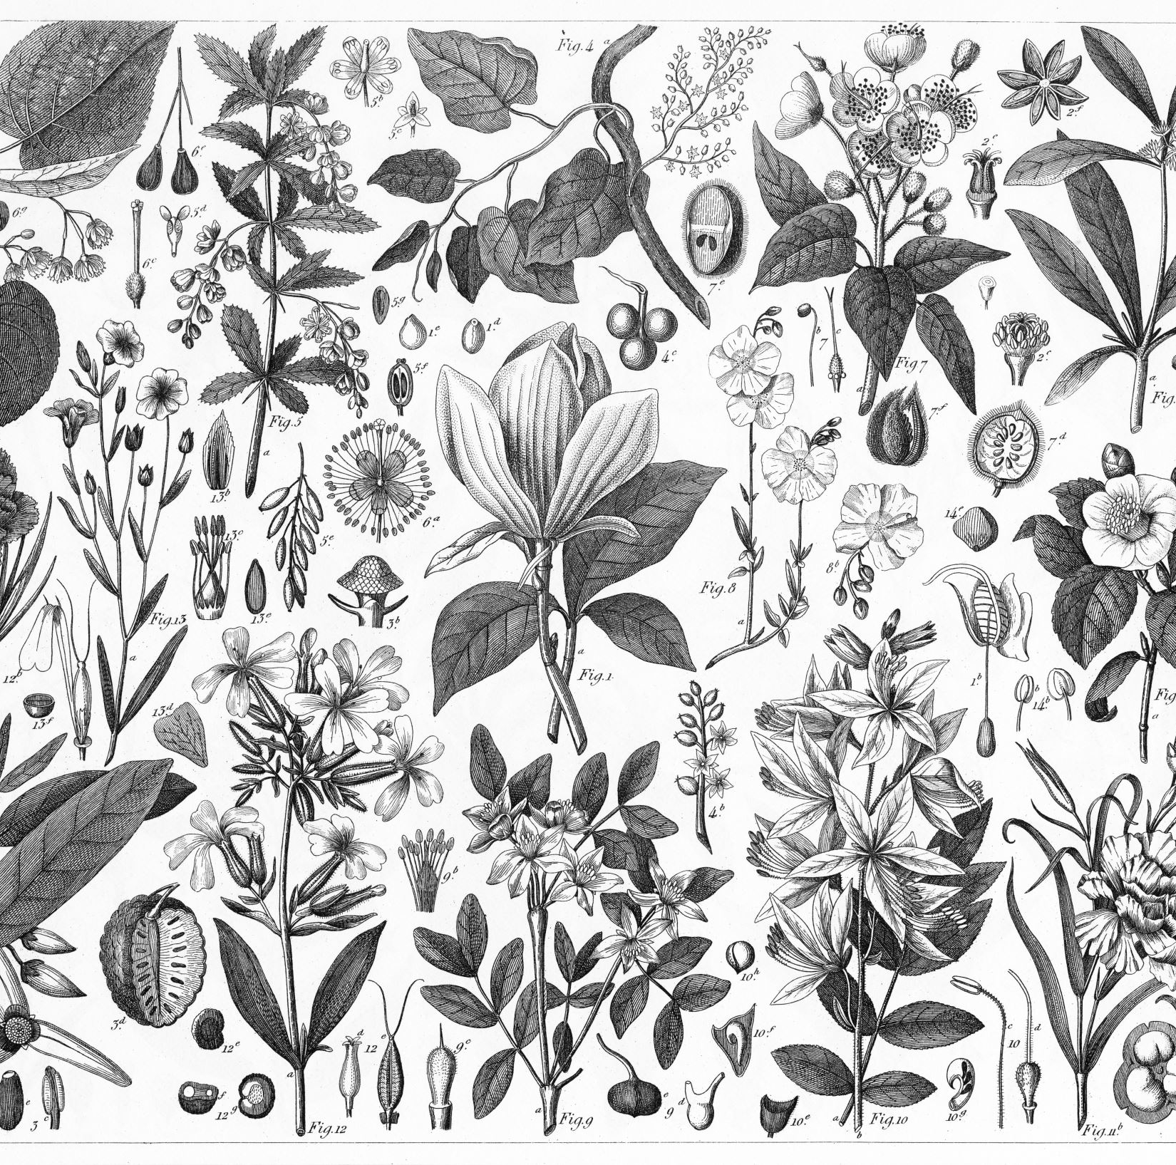
Artists you could research for each category
Monoprinting: Paul Gauguin, Marc Chagall, Joan Miro, Henri Matisse, Tracey Emin
Press Printing: Delita Martin, Kate Turnbull, Henry Bradbury
Collography: Estella Scholes, Clare Maria Wood, Suzie MacKenzie, Hester Cox, Vicky Oldfield,Glen Alps and Sue Brown.
Etching: Pablo Picasso, Lucien Freud, Lynette Yiadom-Boakye
Lino Printing: Margaret Preston, Edward Bawden, Sybil Andrews, Henri Matisse, Pablo Picasso
Screen Printing: Andy Warhol, Peter Blake, Clare Halifax, Laurie Hastings
I hope you enjoy this bridging project and bring me in some wonderful experiments.
Have a lovely summer and see you all soon ☺

