Slide 1
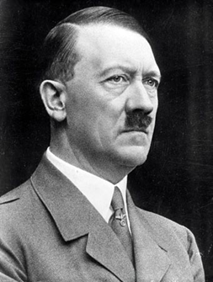
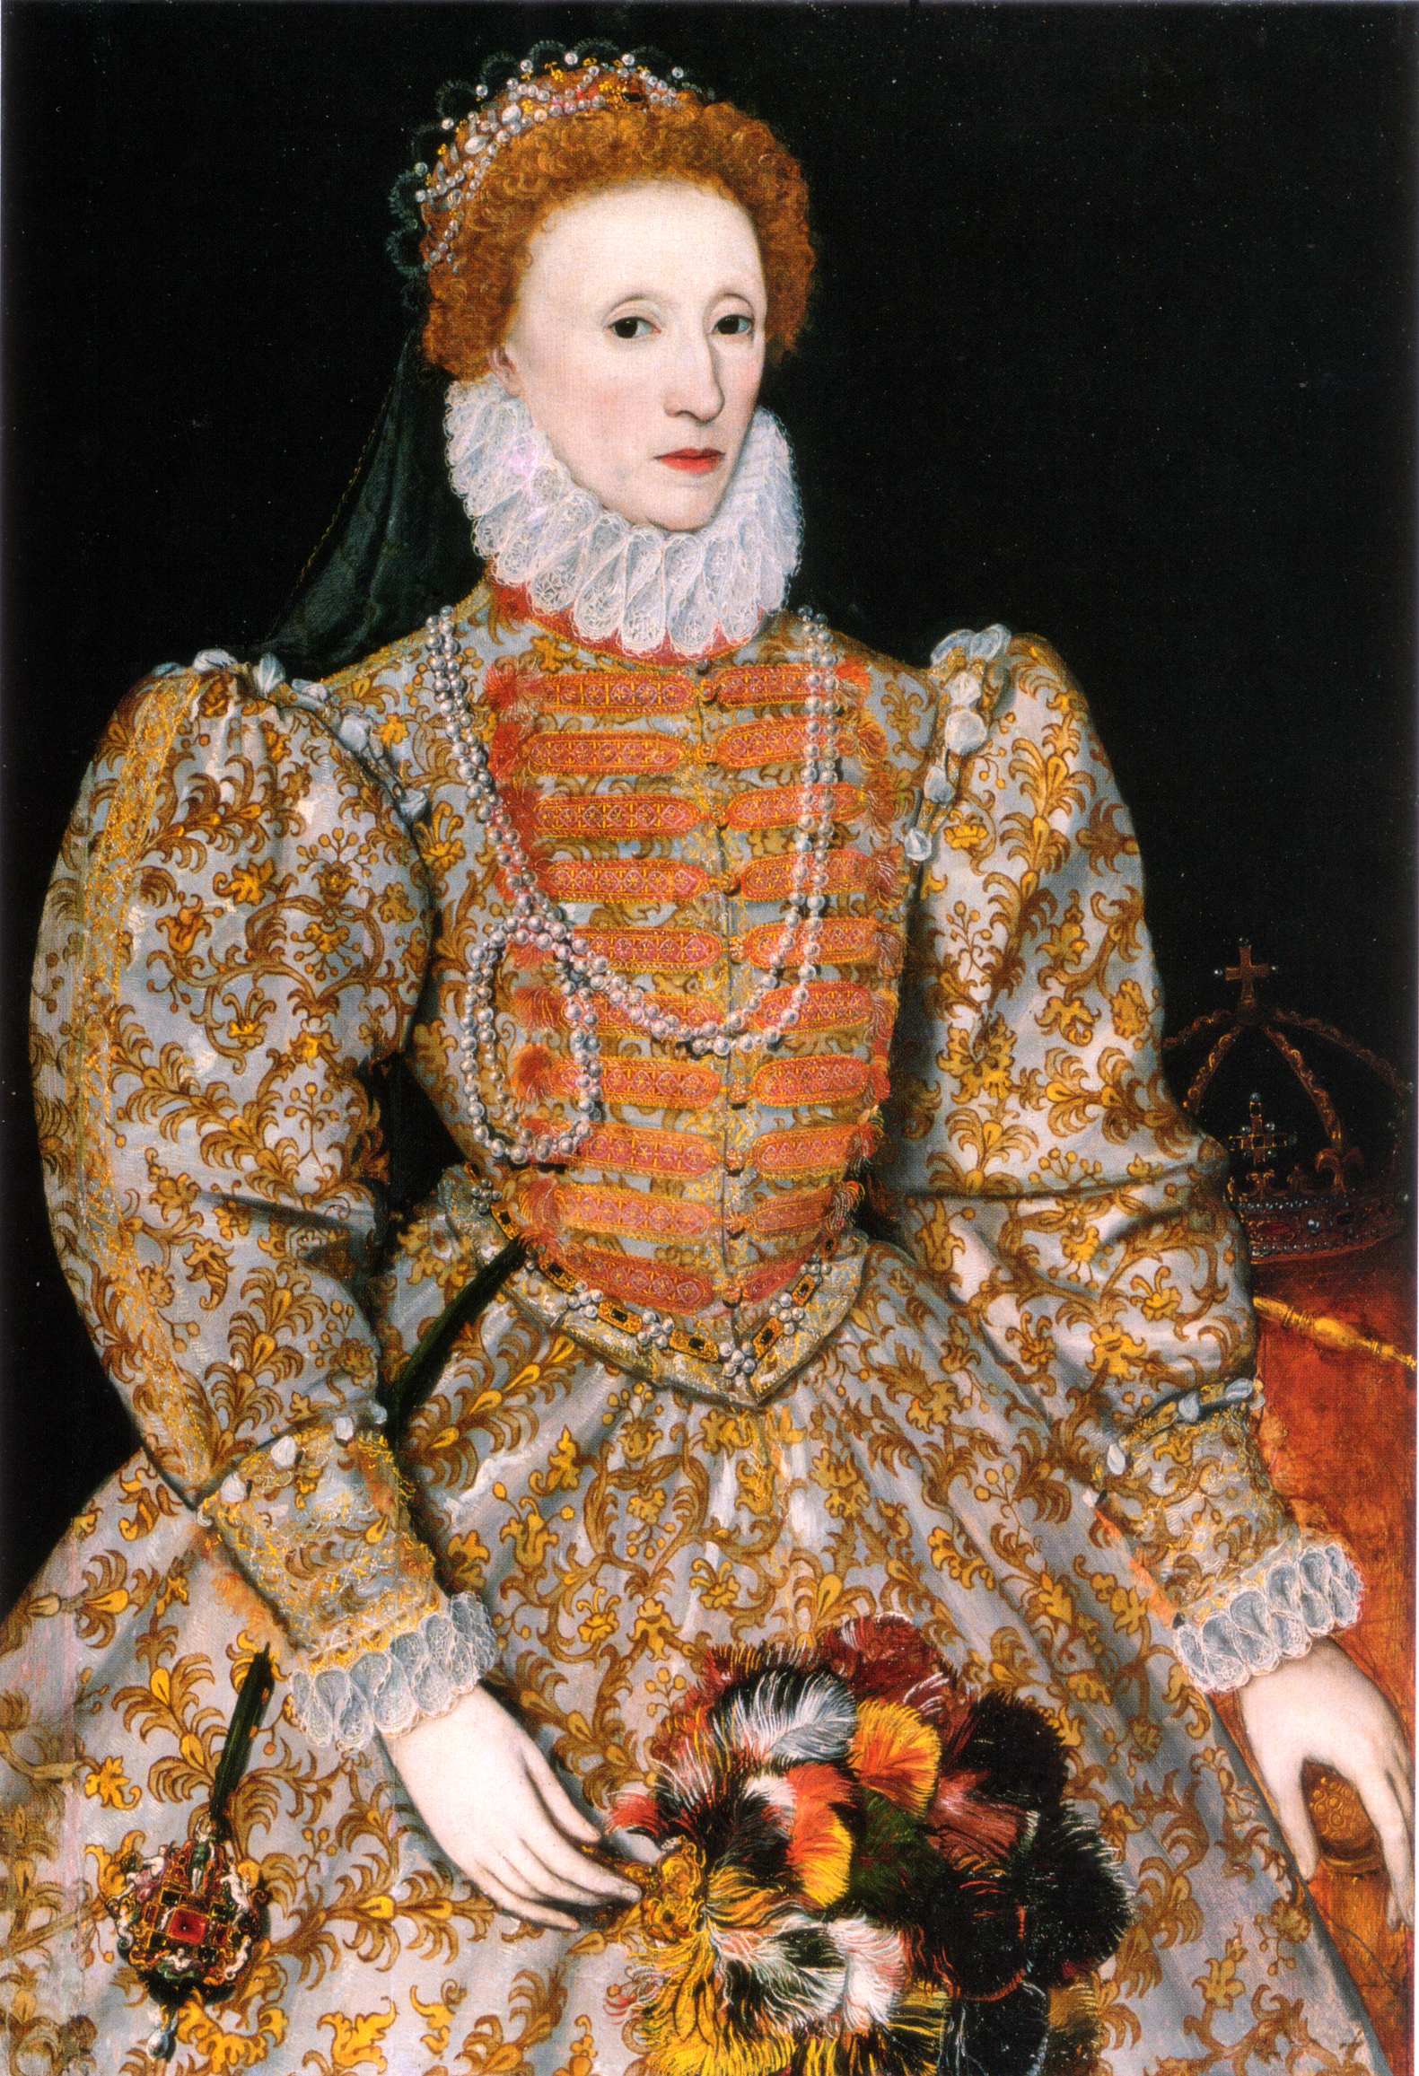
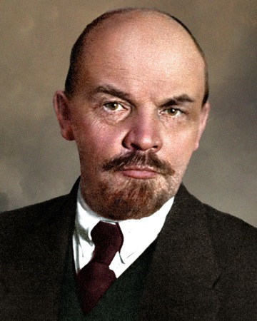
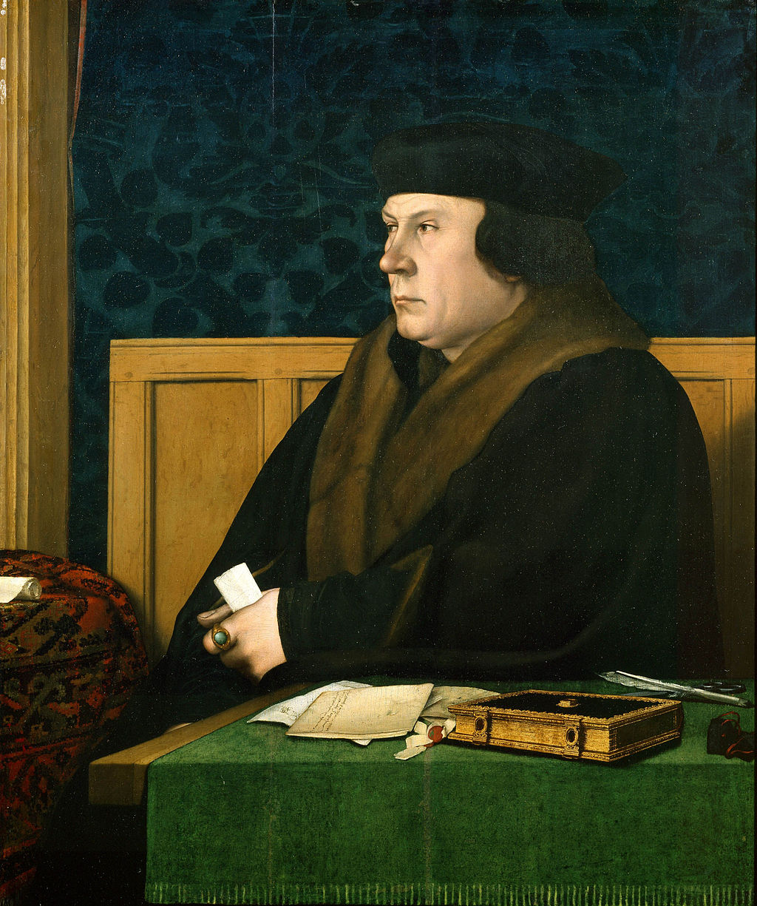
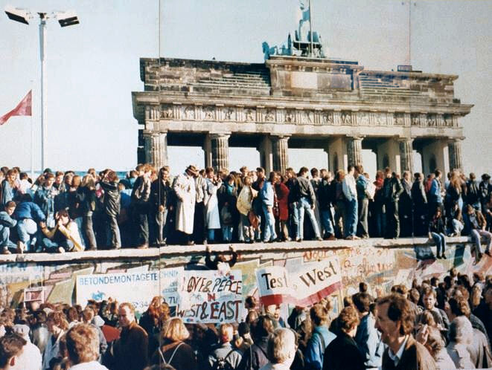
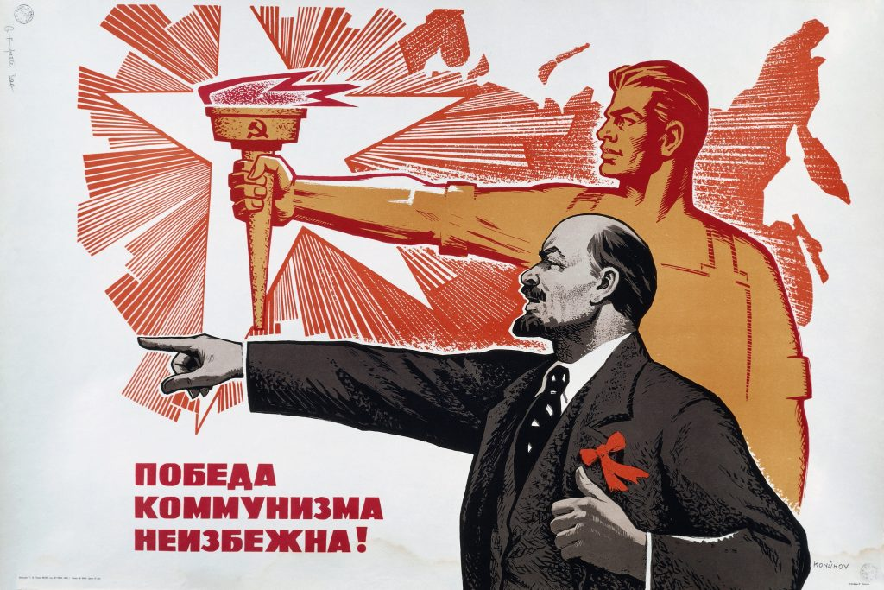
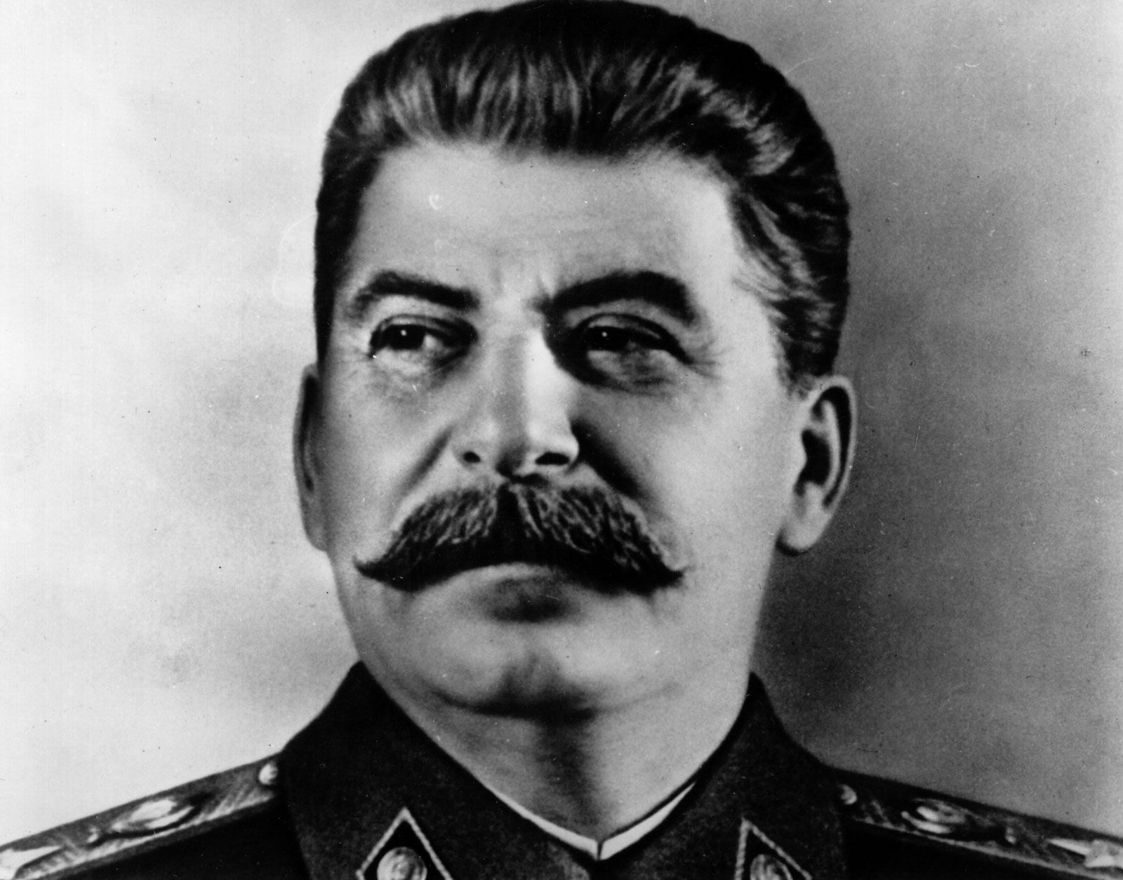
Bridging Work
Name: _________________________

Slide 2
Task 1:
Tudor Timeline
Knowing when events happened is the first step to understanding in History.
Start to get to grips with Tudor chronology by complete the timeline tasks below. This timeline will be a useful reference for you throughout the two year course.
TASKS
(1) Indicate when each of the Tudor monarchs ruled
(2) Find out the dates of the key events below and add them to your timeline
14__: Henry Tudor invades and defeats Richard III at the Battle of Bosworth and is crowned king Henry VII.
14__: Henry and Elizabeth marry; Prince Arthur is born.
14__: Lambert Simnel invades from Ireland, and is defeated at Stoke; the Wars of the Roses end.
14__: Treaty of Etaples with France
149__: Perkin Warbeck, pretender to the Crown, emerges in Ireland; three years later the Scots invade in support of Warbeck
15__: Arthur and Catherine of Aragon marry; Arthur dies the next year
15__: Henry VII dies and Henry VIII ascends; Henry and Catherine of Aragon marry.
15__: Wolsey becomes a cardinal; Princess Mary is born.
15__: Henry writes a book on his Catholic beliefs.
15__: Henry starts divorce proceedings against Catherine.
15__: Wolsey fails to find a solution to Henry’s divorce and Henry fires him.
15__: Henry finally marries Anne Boleyn; Archbishop Cranmer declares Henry’s first marriage null; Act in Restraint of Appeal severs ties to Rome; Elizabeth is born.
15__: Parliament passes the Act of Supremacy
15__: Pilgrimage of Grace; the English Bible is approved; Henry executes Anne and marries Jane Seymour.
15__: Prince Edward is born; Jane dies.
15__: Act of Six Articles
15__: Henry marries and divorces Anne of Cleves; Thomas Cromwell falls; Henry marries Catherine Howard.
15__: War with France; attack on Scotland; fall of Boulogne.
15__: England defeats a potential French invasion; Mary Rose sinks.

Slide 3
15__: Henry VIII dies; Edward VI – aged 9 – becomes king; duke of Somerset forms the protectorate
15__: Act of Uniformity; first Book of Common Prayer issued; rebellions in Devon and Norfolk; Somerset falls.
15__: Second prayer book issued.
15__: Edward VI dies;; Mary succeeds and returns to the old ways in religion.
15__: Mary marries Philip II of Spain; England and Rome are reunited.; the next year Mary starts burning Protestants
15__: Mary dies; Elizabeth becomes queen.
15__: Elizabethan Religious Settlement: new Acts of Supremacy and Uniformity
15__: Mary Queen of Scots arrives in England as a fugitive
15__: Revolt of the Northern Earls
15__: Papal bull excommunicates Elizabeth.
15__: Spanish Armada is defeated
15__: Tyrone’s revolt in Ireland begins
16__: Elizabeth dies; Robert Cecil secures the peaceful accession of James VI of Scotland.

Slide 4
Task 2:
Historical Interpretation
A key skill to develop at A level is how to analyse and evaluate what historians have said about the past in historical interpretations.
This can be tricky because historians often write for an academic audience who they assume already know something about the topic!
This task will help you to break down the interpretation so you can summarise what the historian is saying.
J.J. Scarisbrick, Henry VIII (1968)
He had survived pretenders, excommunication, rebellion and threats of invasion, died in his bed and passed his throne peacefully to his heir… He had made war on England’s ancient enemies and himself led two assaults on France. For nearly four decades he had cut an imposing figure in Europe…bestriding its high diplomacy as few of his predecessors, if any, had done. He had defied the pope and emperor, brought into being in England… a national Church subject to his authority, wiped about a thousand religious houses off the face of his native land…and bestowed on English kingship a profound new dignity. He… had brought Scripture in the vernacular to his people, hesitantly and perhaps partly unwittingly, but none the less decisively, allowed his country to be directed towards the Continental Reformation… and given to his people a new sense of unity – the unity of ‘entire Englishmen’.
What did Henry VIII survive?
What did he achieve in warfare and foreign affairs?
How did he change the religious experience in England?
How did he boost nationalism?
Do you think Scarisbrick thinks Henry was a success or not? Explain your answer using evidence from what he says.

Slide 5
Task 3: Making Notes
Making good, detailed notes will help you to learn and overlearn knowledge. Watch the documentary and fill in the sections below to practice making notes and organizing ideas.
How is Henry VIII described at the start of the documentary?
 | Impact | What led to their decline?
Cardinal Wolsey
Thomas Moore
Thomas Cromwell

Slide 6
Task 4:
Introduction to Russia
The second topic you’ll study is based on Russia 1917-53.
We’ll properly introduce what Russia in 1917 was like…
…but for now you should find out some basic information about Russia so we can start to speculate how Russian history still influences the Russians today.
Google: introduction to Russia
Make an A4 profile detailing:
Geography
Economy
Population
Government
Brief history from c1500-1991

