Slide 1
Independent Learning
Bridging Tasks
A Level Product Design - AQA - 7552
https://www.aqa.org.uk/subjects/design-and-technology/as-and-a-level/design-and-technology-product-design-7552
Hello, Welcome to A Level Product Design. I am Mr Hussain one of the teachers. I look forward to meeting you all and working together.

Slide 2
More Draw
Listen
Read
Calculate
Watch
Draw
Create
Click on the command word to take you to each task
Write

Slide 3
Watch the video
Use the link below to browse tutorials, select a few and have a go. This work should all go into your portfolio. Bring into class in september to share.
Draw
https://www.sketch-a-day.com/videos

Slide 4
Read
Read this article
Identify the key points and bullet note.
https://www.designcouncil.org.uk/news-opinion/what-do-we-mean-design

Slide 5
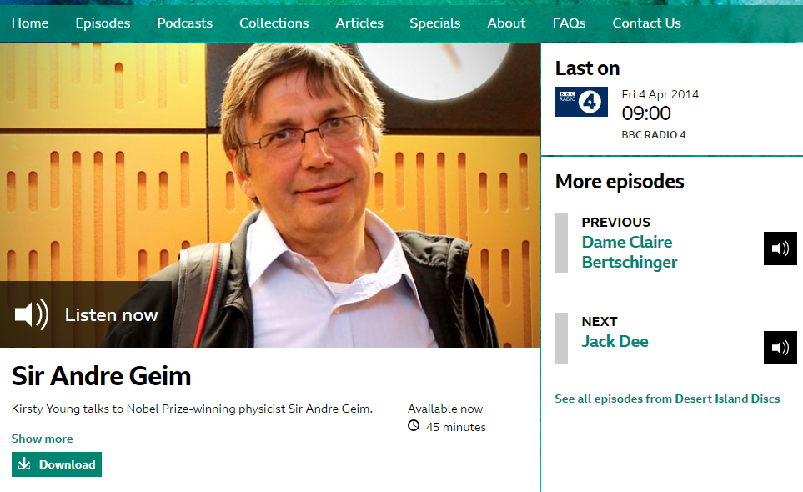
Listen
https://www.bbc.co.uk/programmes/b03z3l2g
Listen to the podcast
What are your thoughts? Jot them down or make a voice recording to share in class.

Slide 6
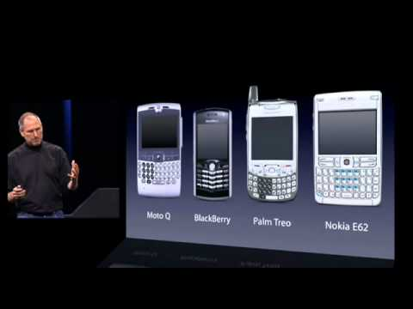
Watch
Watch the video
Is this iconic? Why?

Slide 7
Create
Draw the dinosaur parts onto thin card (cereal box turned inside out is ideal.
Cut out the shapes and slot together to make a 3d object
Using this technique, develop a range of 3d creatures and characters, take photos to share.

Slide 8
(a) Explain what you understand by the term iconic design.
In your answer you should refer to at least four criteria that could be used to define a
product as being an iconic design.
(14)
(b) Describe a product that you believe to be an example of iconic design and show how the product meets the criteria you have given in part (a).
You must use sketches in your answer to identify key features.
(14)
(Total 28 marks
Write
Markscheme click here
Read this exam question and the mark scheme
Create a mind map of iconic design, examples and what makes them iconic

Slide 9
MarkScheme
(a) Candidates may begin / or include a definition of ‘iconic design’ eg
• Exhibits elements of – originality, excellence, utility
• Stands the test of time
• Sets bench marks for others to follow etc.
Anticipate examples being given to support explanations, links to modern design,
principles of form / function, innovation / invention.
(b) Example iPod although not yet perceived to be long lasting, has originality, sets bench mark for other MP3 players, status as fashion icon, uses new technology,
simple aesthetics etc.

Slide 10
Calculate
Complete the worksheet below
Press here for worksheet

Slide 11
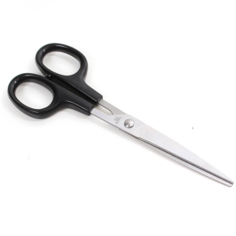
TANAGRAM - INSTRUCTIONS
Using a pencil and a ruler draw a series of lines on your piece of paper.
Cut these out to create a range of different shapes.
Mix these shapes up and play with different positions to create a product.
Re-draw your tanagrams shape.
STRETCH & CHALLENGE.
Can you name the geometric shapes within your tanagram?
Can you measure ALL dimensions in (mm) and (cm)?
Can you work out the area of the shape?
Can you measure the angles of the shapes using a protractor?
© HDU

Slide 12
More Draw
https://cad.onshape.com/signin?geocountry=United%20Kingdom&geostate=ENG&geocity=Hemel%20Hempstead
Click on the link. Open an Onshape account, use your school email account.
Watch the video tutorial and have a go. There are loads more tutorials online. Screenshot your work to share in class.

